Slide 1
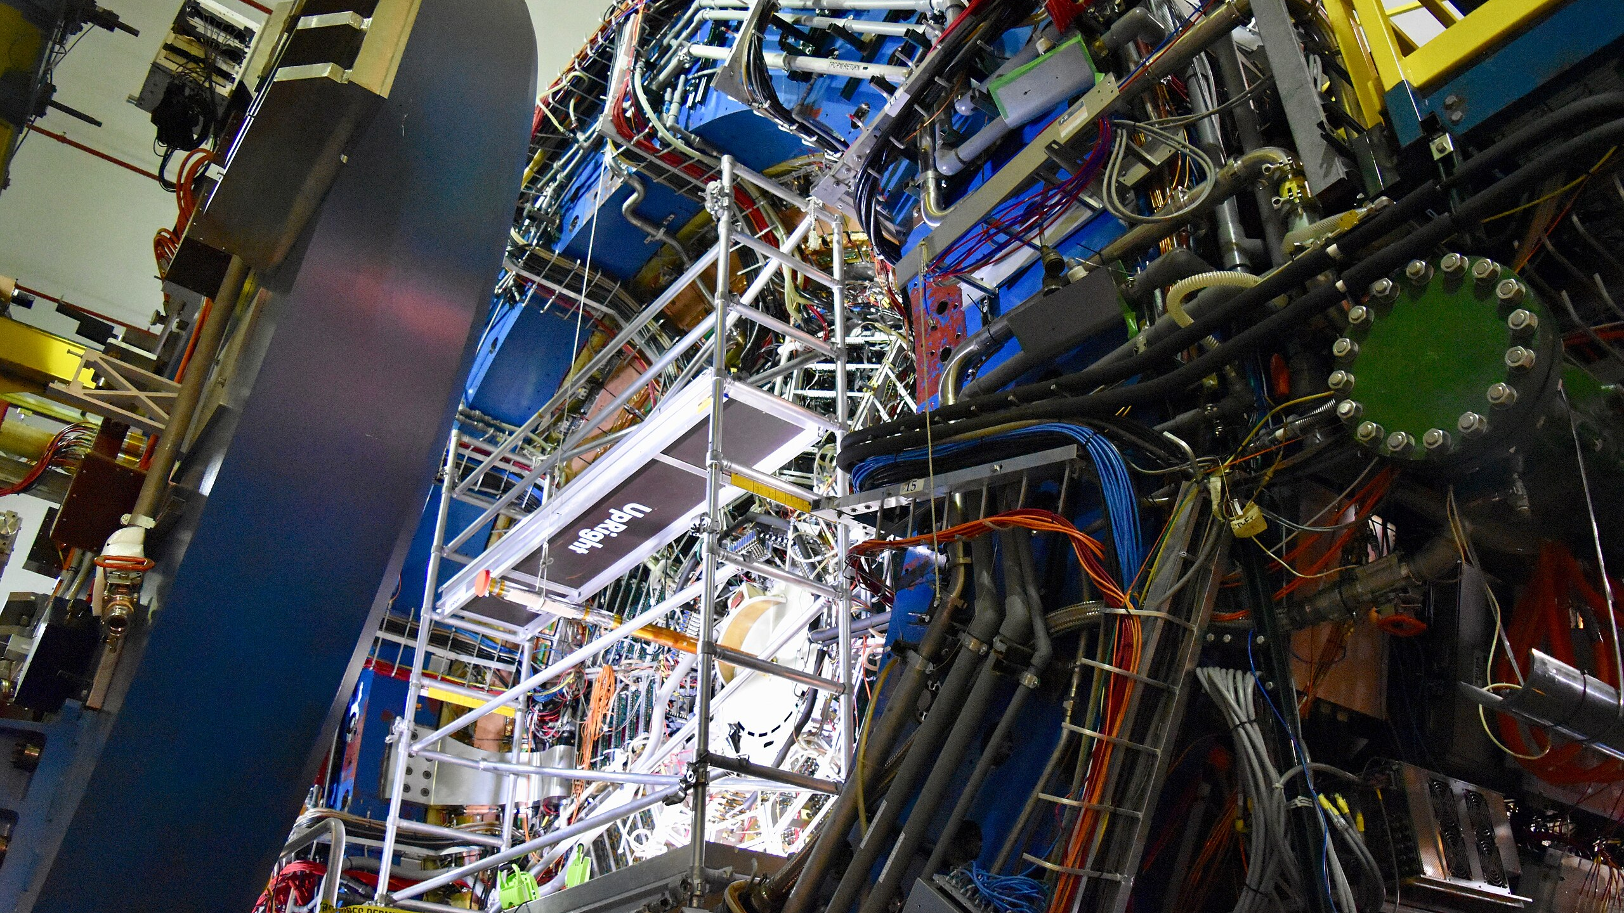
Temperature Evolution of the Speed of Sound from Heavy Ion Collisions using Trajectum – a Heavy Ion Collision Model
By Christian Schmidt, Caleb Broodo.
Advisor: Dr. Rene Bellwied.
Department of Physics, University of Houston
Fall 2025 Joint Meeting of the TAOAPS, Texas Section of the AAPT & Zone 13 of the SPS – 10/10/2025

Slide 2


Outline
What is Trajectum?
Measuring the speed of sound $c_{s}^{2}$ as a thermodynamic state variable
$T_{eff}$ and Lattice Quantum Chromodynamics (QCD)
Results from Trajectum
Commentary

Slide 3
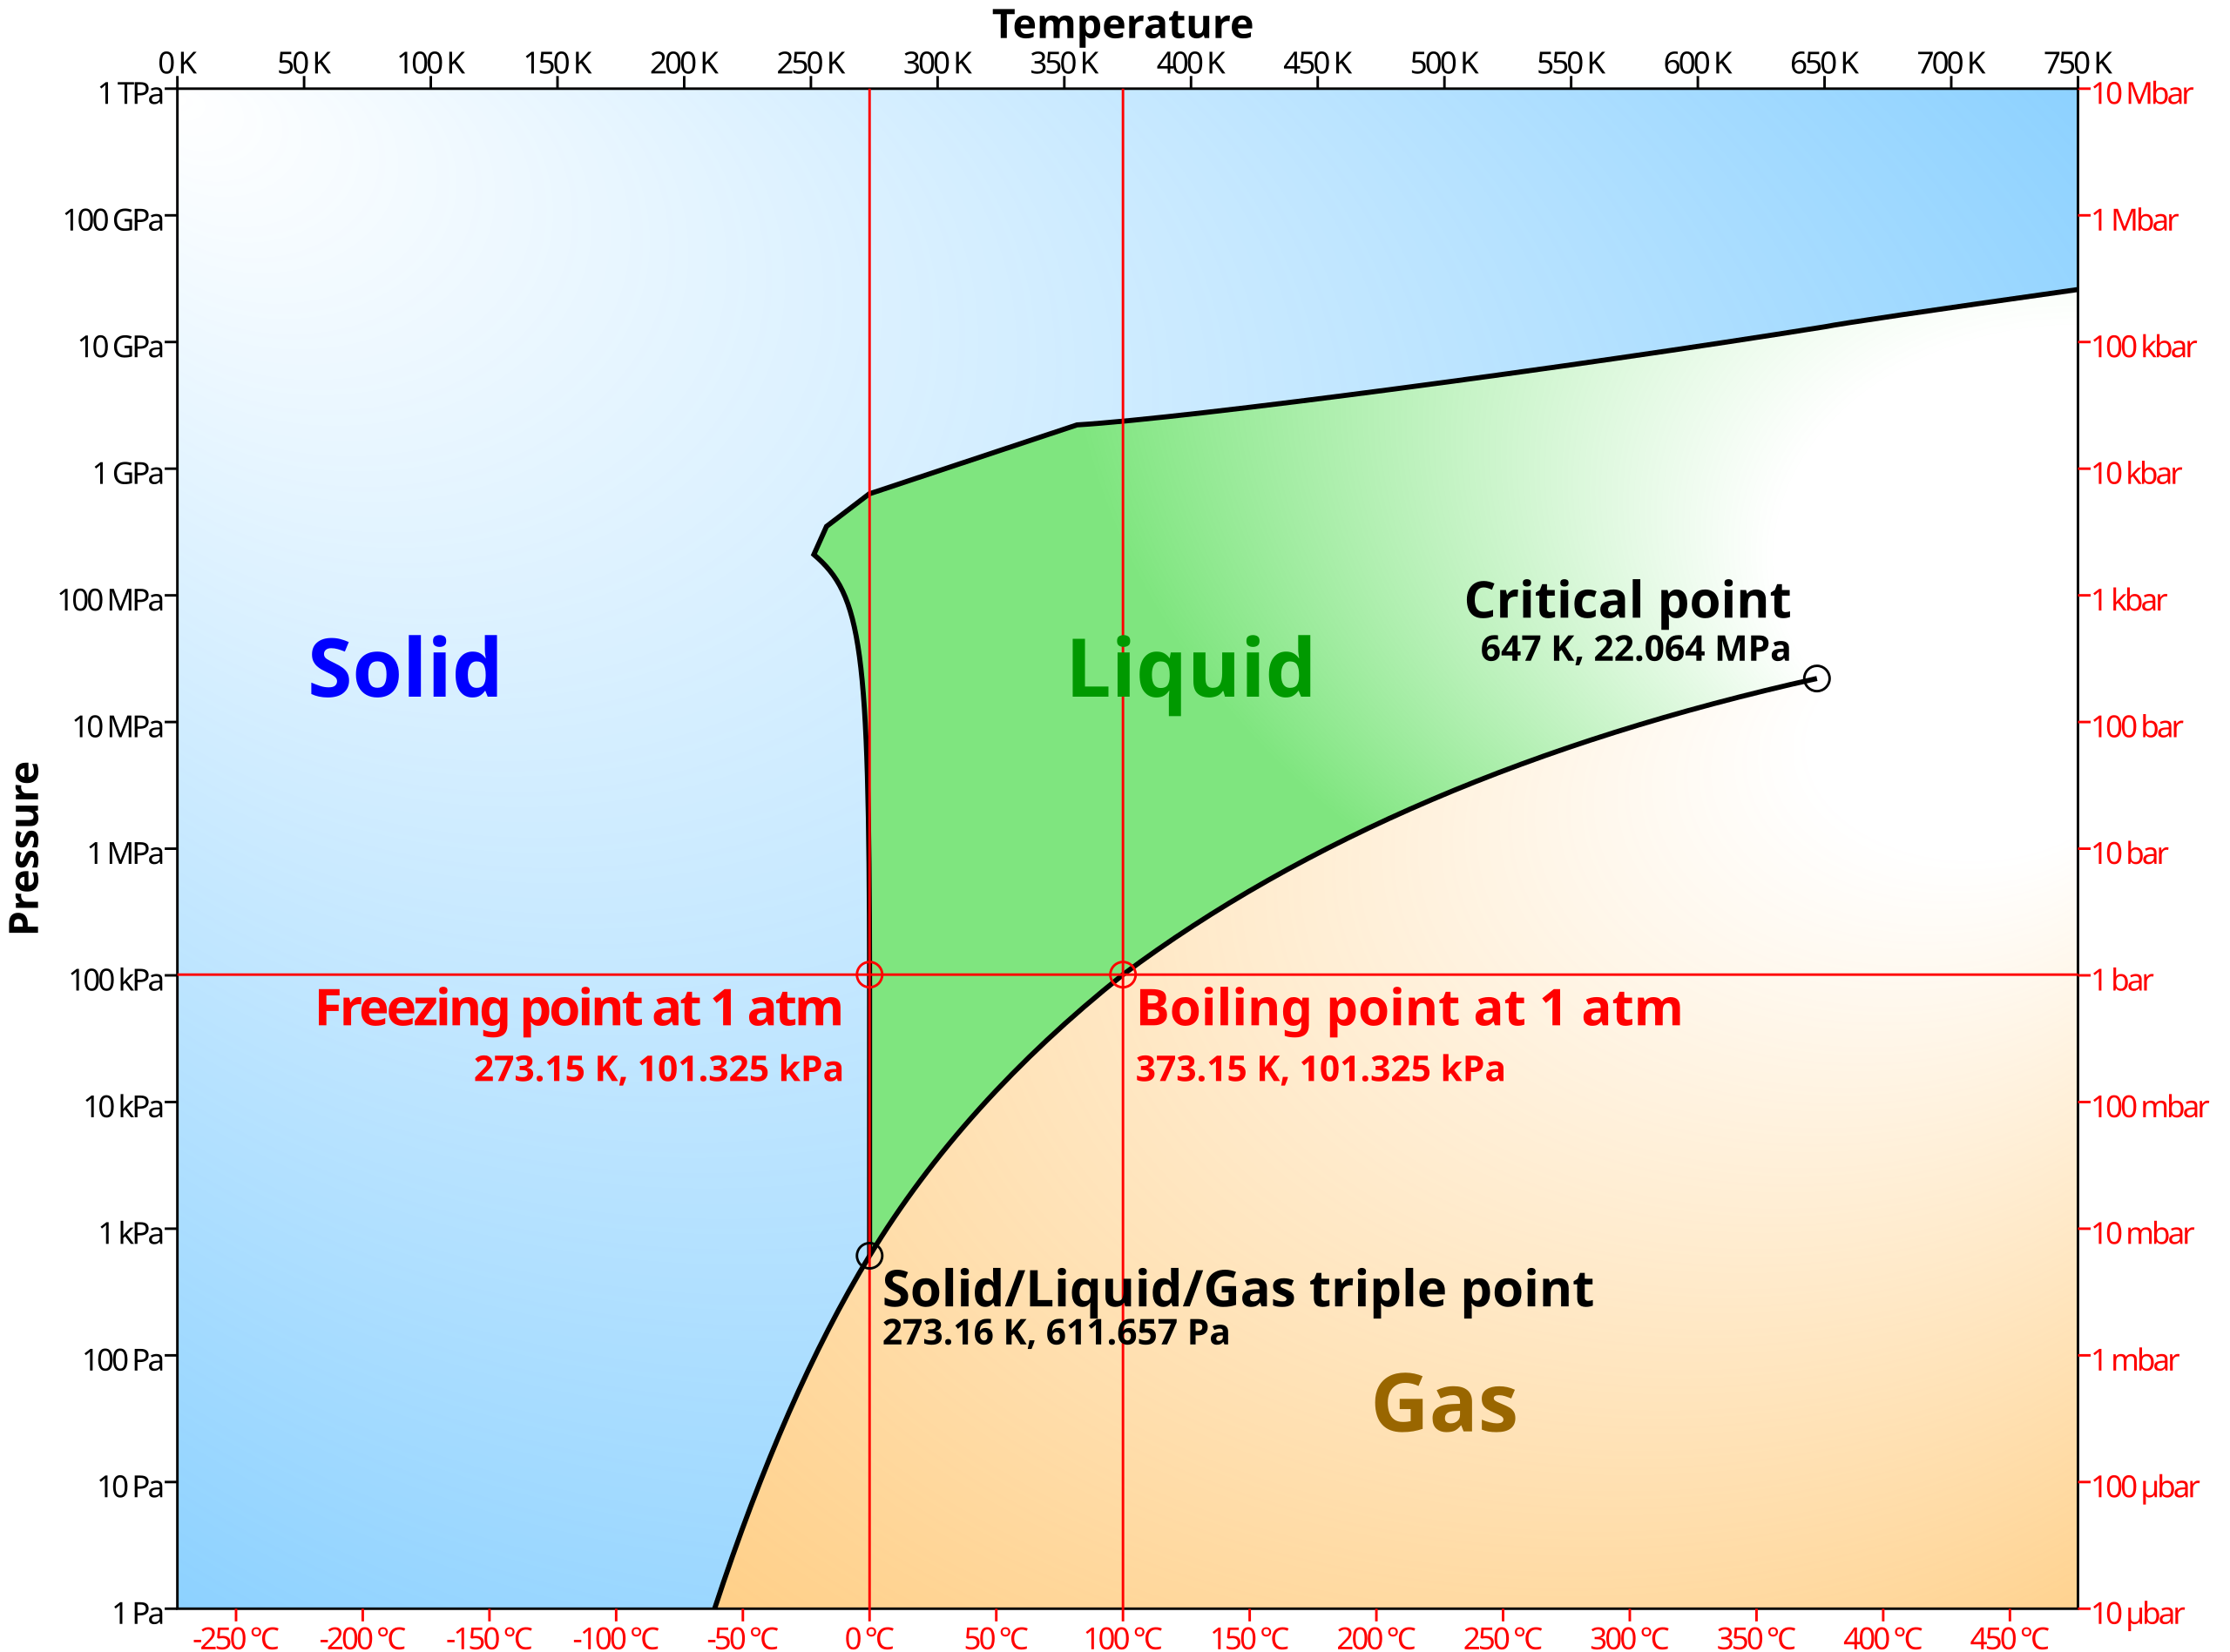
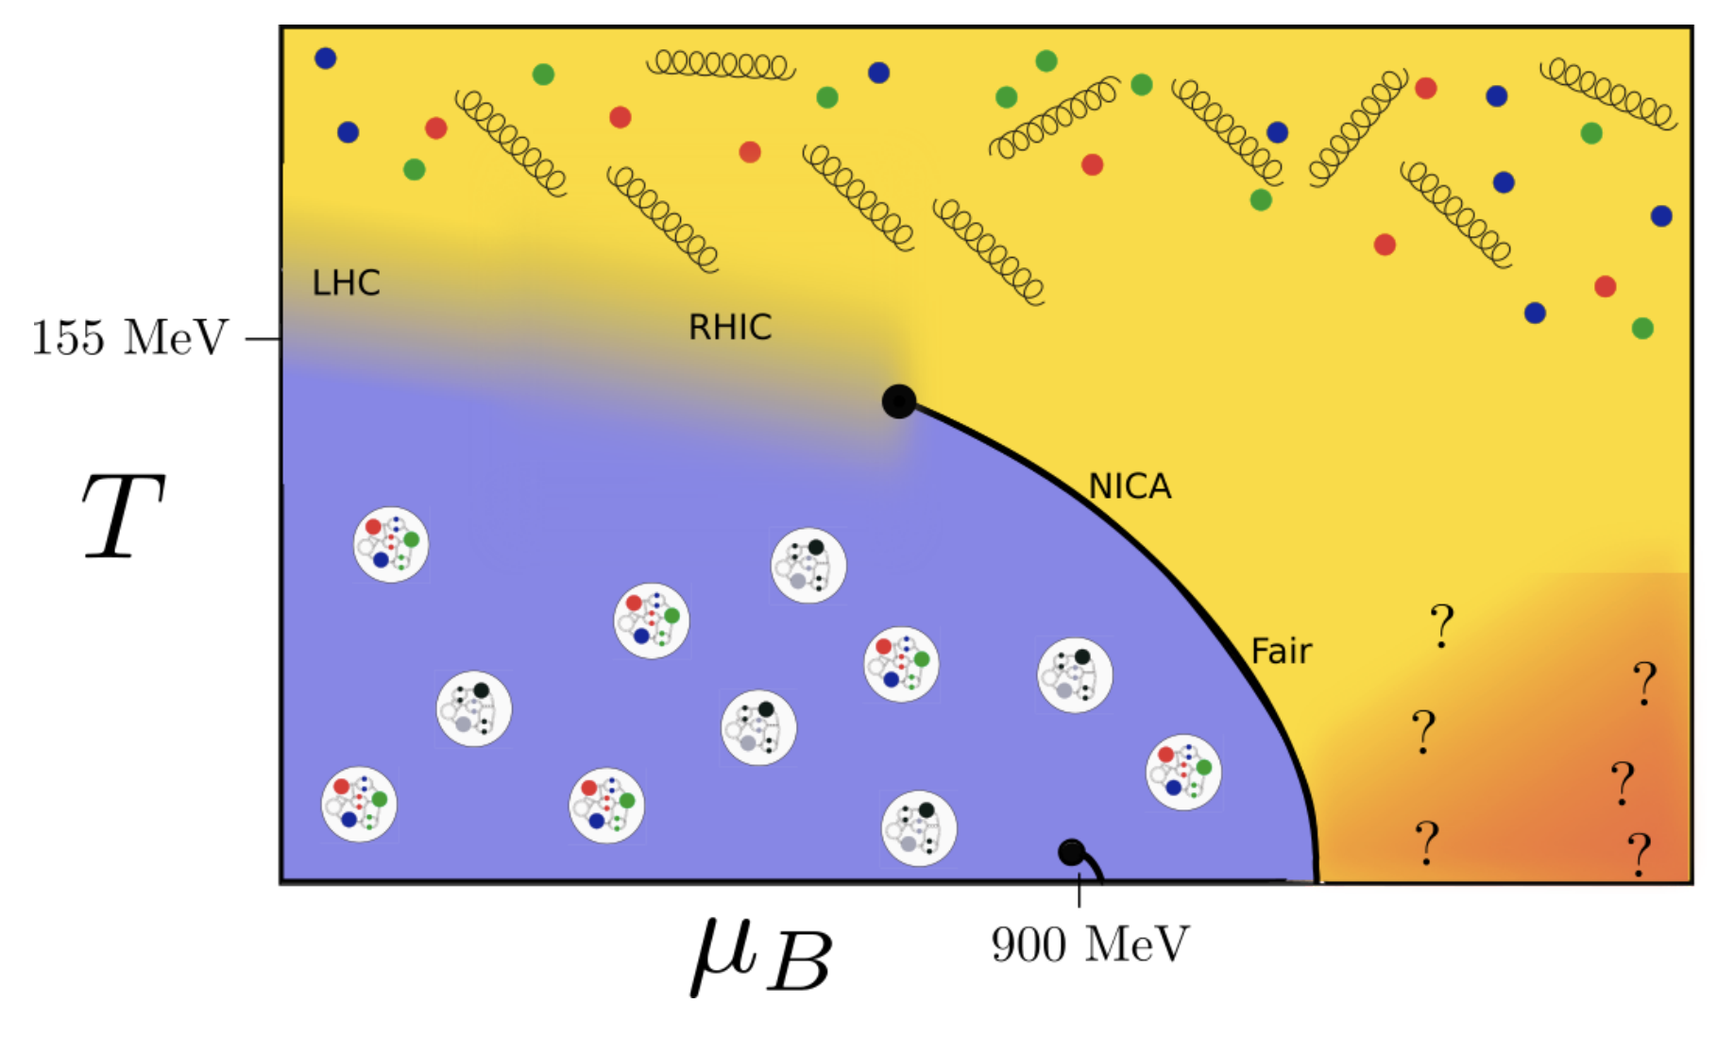
What is Trajectum?
Trajectum is a set of programs to simulate nuclear collision experiments.
A hydrodynamic modeling code (partonic → hadronic).
Provides data of final state observables
We are studying Trajectum to understand the equation of state (EOS) of nuclear matter across different collision energies.
Trajectum’s tunability
Significance to the QCD phase diagram.
[arXiv:2010.15503]

Slide 4
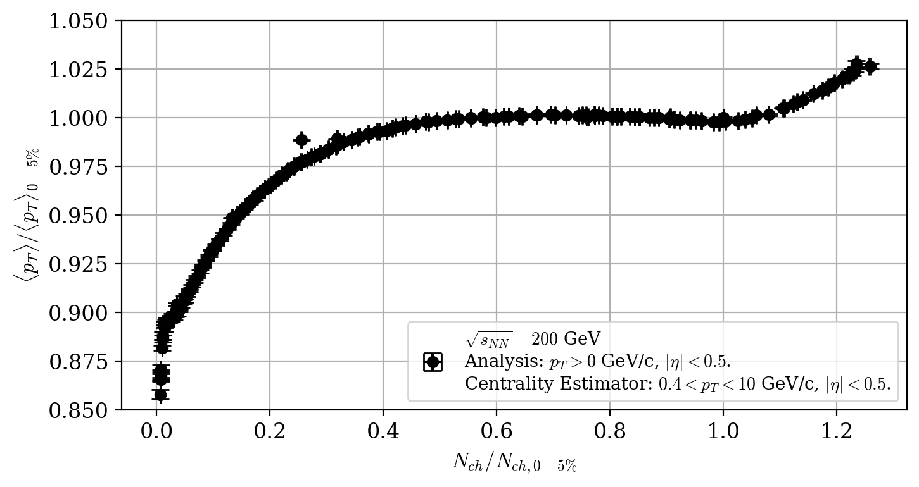


Speed of sound $c_{s}^{2}$
$c_{s}^{2}$ as a thermodynamic state variable.
The equation – mechanics, thermodynamics, observables:
$c_{s}^{2}=\frac{∂P}{∂ε}=\frac{dln(T)}{dln(s)}=\frac{dln\left\langle p_{T}\right\rangle }{dln\left\langle N_{ch}\right\rangle }$
What is centrality?
It is a percentage of total events.
The ultra-central argument [arXiv:1908.09728]
The takeaway: for ultra-central collisions, $V$ is fixed, so $N_{ch}≃s$.
Power law fit: $\left(\frac{{⟨p}_{T}⟩}{{{⟨p}_{T}⟩}_{0−5\%}}\right)∝$ ${\left(\frac{N_{ch}}{N_{ch,0−5\%}}\right)}^{c_{s}^{2}}$
What behavior do we see as we change $\sqrt{s_{NN}}$? What behavior should we see, according to theory?
Peripheral:
Geometry-driven
Ultra-central:
New physics!

Slide 5
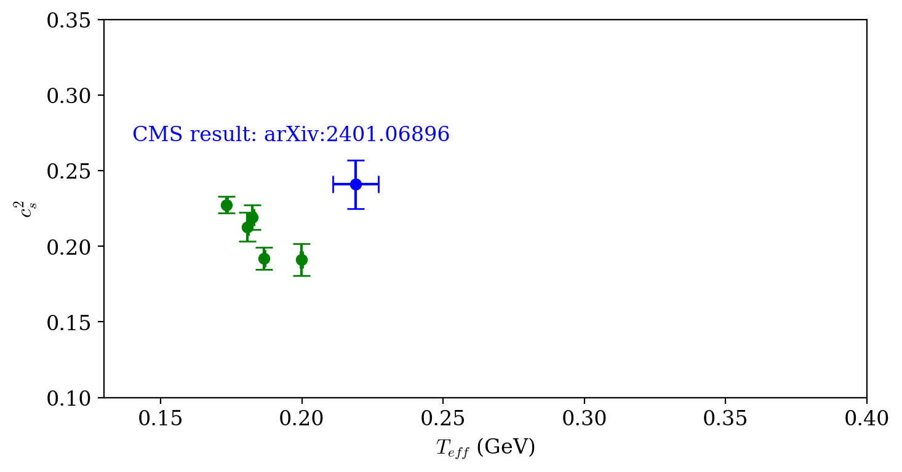
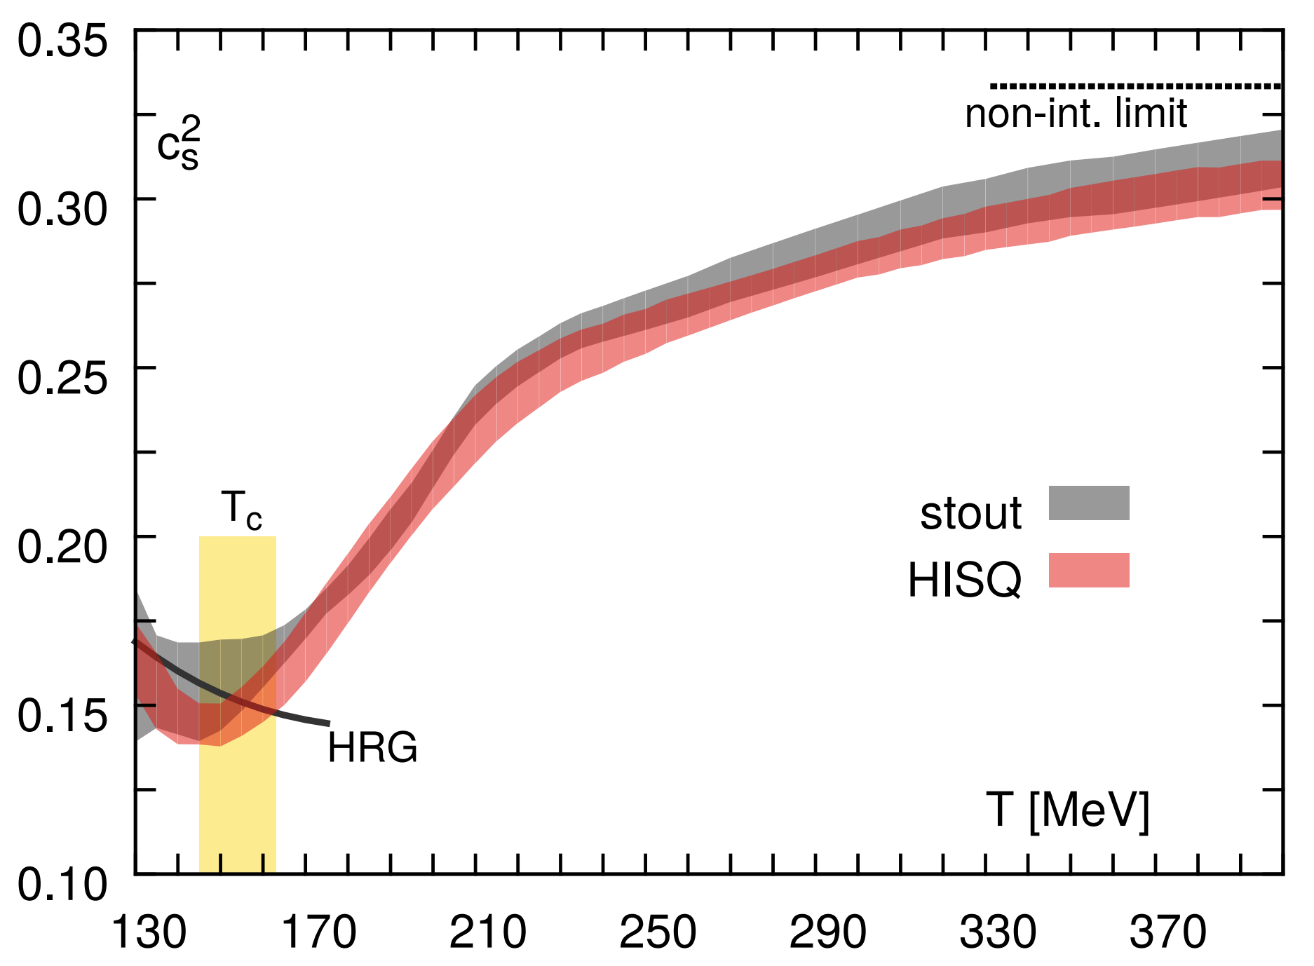
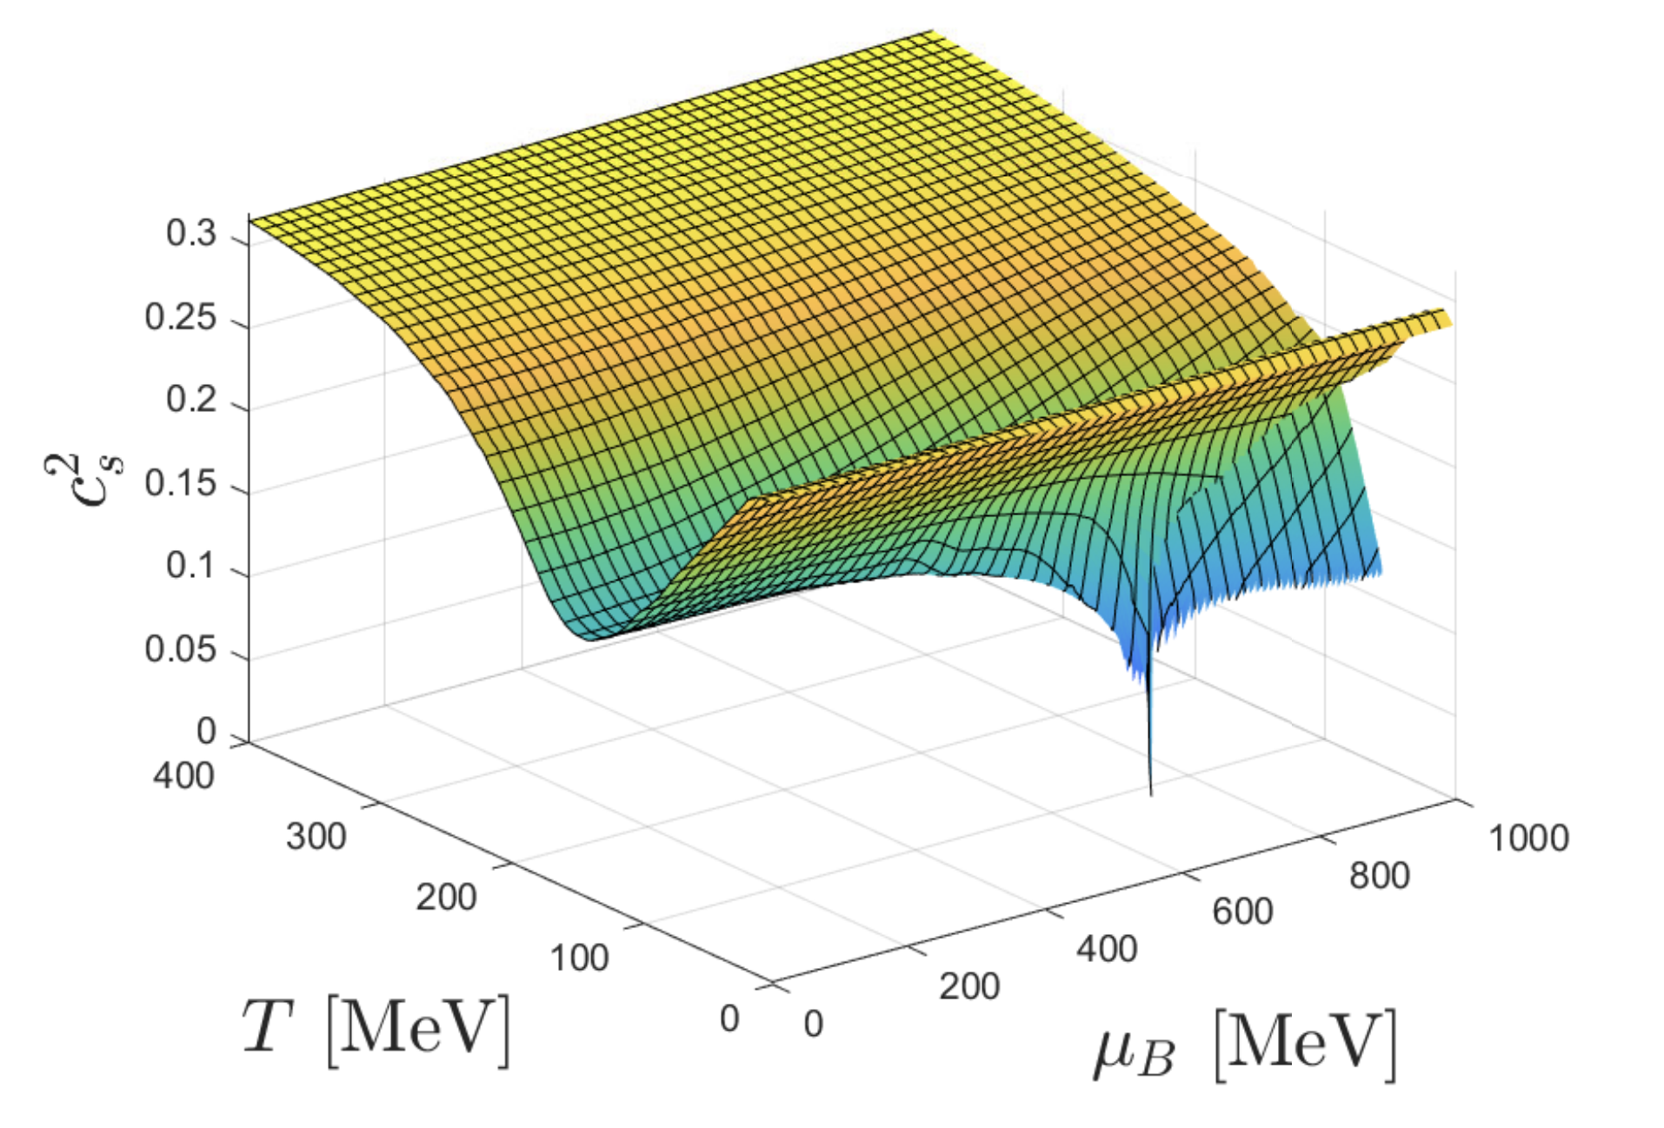


$T_{eff}$ and Lattice QCD
$T_{eff}$ - average temperature corresponding to a $c_{s}^{2}$ measurement
$T_{eff}≈\frac{{\left\langle p_{T}\right\rangle }_{0−5\%}}{3}$ [Nat. Phys. 16 (2020) 615]
Increases with $\sqrt{s_{NN}}$ - insightful to the EOS?
Upper: Lattice QCD prediction for $T_{eff}$ vs. $c_{s}^{2}$
[arXiv:1407.6387, 1309.5258].
Lattice QCD curve at $μ_{B}=0$ MeV above; contour plot shows $μ_{B}$ dependence

Slide 6
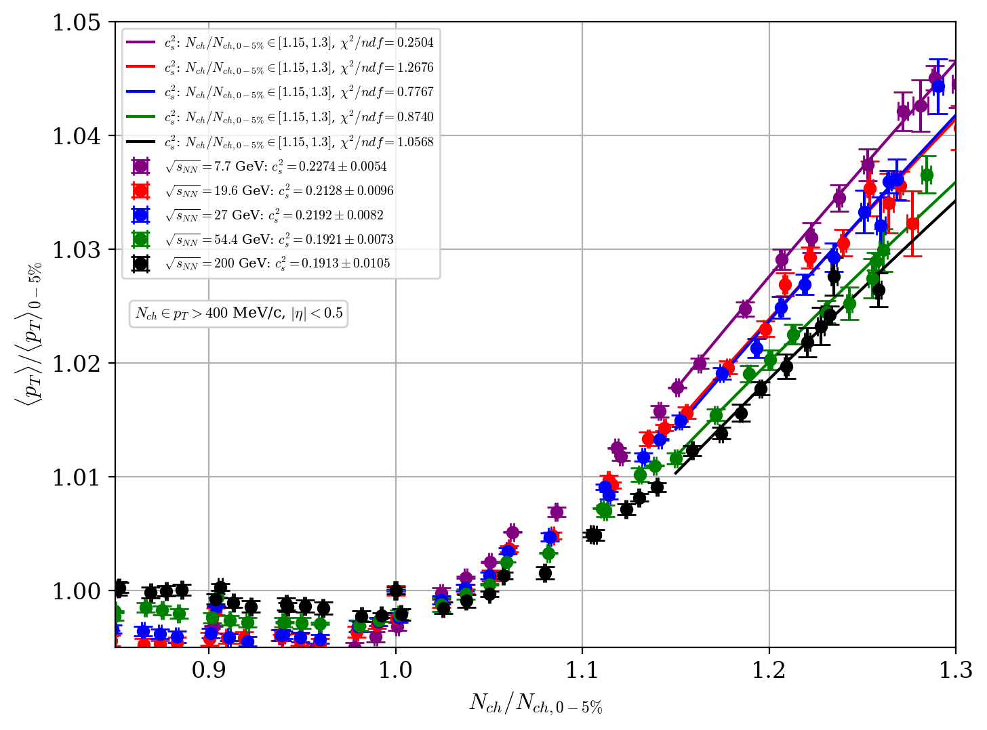

Results from Trajectum
$c_{s}^{2}$ results from Trajectum at various STAR collision energies:
$\sqrt{s_{NN}}=200$ GeV ($μ_{B}=25$ MeV)
$\sqrt{s_{NN}}=54.4$ GeV ($μ_{B}=84$ MeV)
$\sqrt{s_{NN}}=27$ GeV ($μ_{B}=154$ MeV)
$\sqrt{s_{NN}}=19.6$ GeV ($μ_{B}=203$ MeV)
$\sqrt{s_{NN}}=7.7$ GeV ($μ_{B}=420$ MeV)

Slide 7
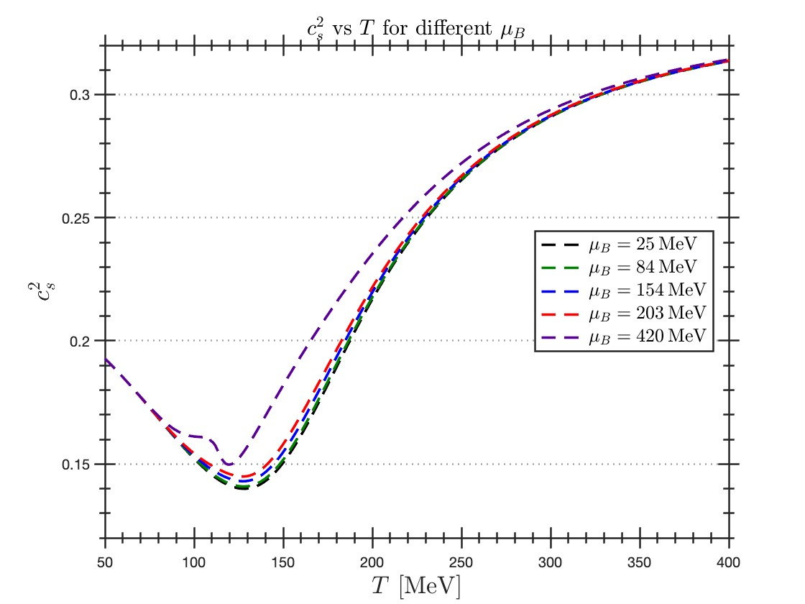
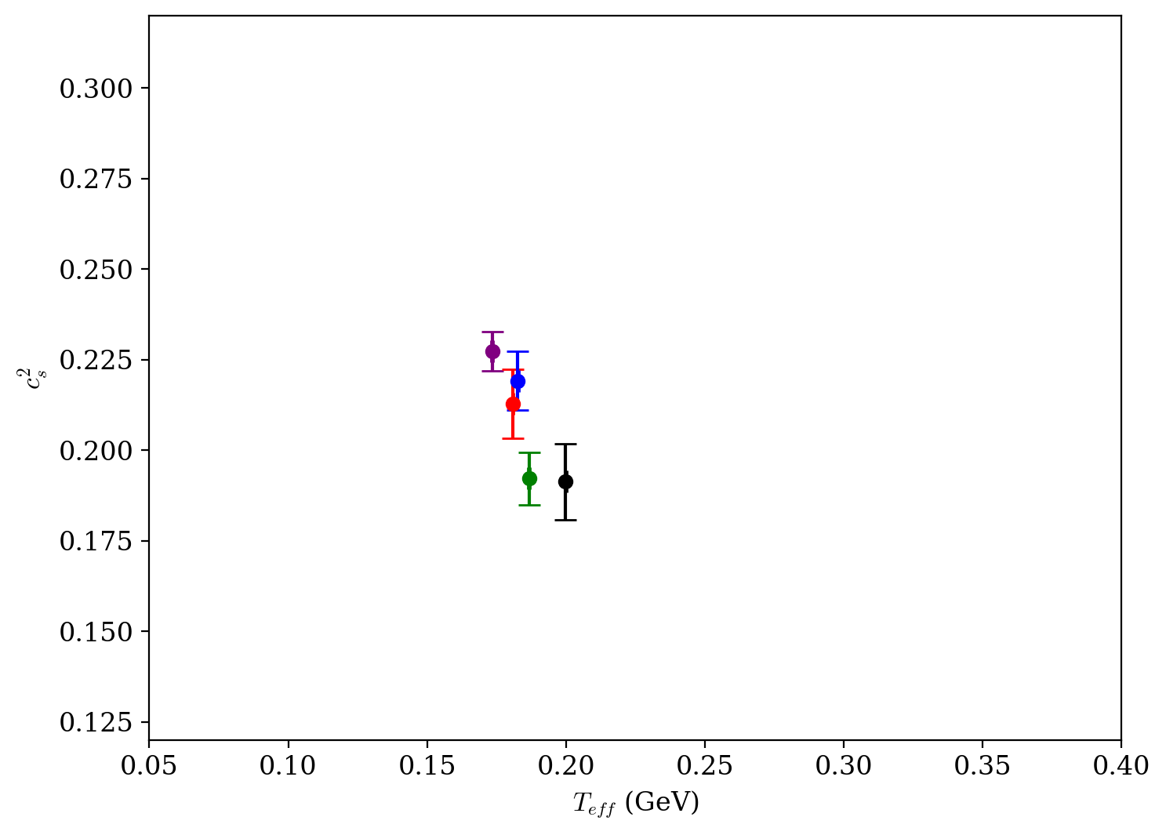

Results from Trajectum
$c_{s}^{2}$ results from Trajectum at various STAR collision energies:
$\sqrt{s_{NN}}=200$ GeV ($μ_{B}=25$ MeV)
$\sqrt{s_{NN}}=54.4$ GeV ($μ_{B}=84$ MeV)
$\sqrt{s_{NN}}=27$ GeV ($μ_{B}=154$ MeV)
$\sqrt{s_{NN}}=19.6$ GeV ($μ_{B}=203$ MeV)
$\sqrt{s_{NN}}=7.7$ GeV ($μ_{B}=420$ MeV)
Overlay these values onto the QCD curve:
Values lie in the bounds predicted by QCD ($c_{s}^{2}∈[0.14,0.33]$), but dynamically disagree with $T_{eff}$.

Slide 8
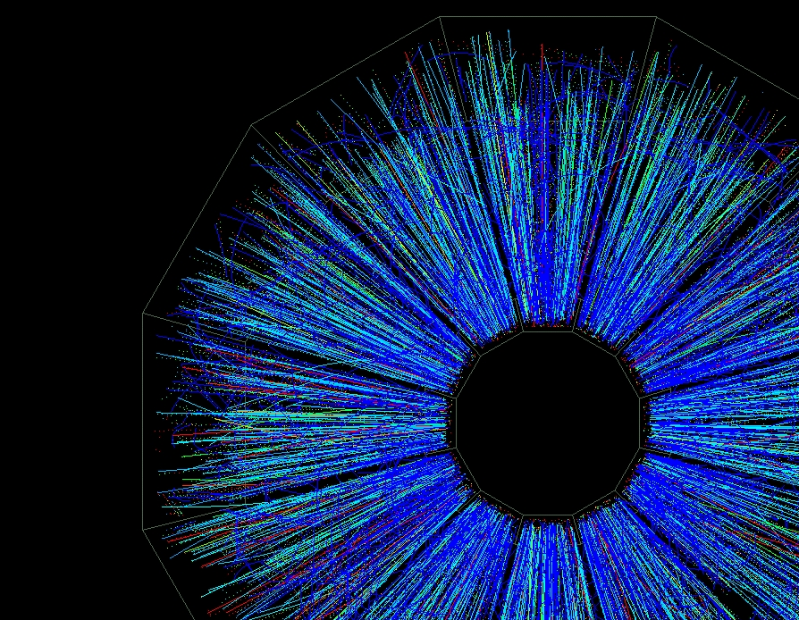

Commentary
How well does Trajectum describe low $\sqrt{s_{NN}}$ collisions?
Emergent physics at low $\sqrt{s_{NN}}$
Hadronic phase contributions?
Are we truly measuring $c_{s}^{2}$?
Theoretical uncertainties, sensitivities, and the way forward

Slide 9

Summary
We used Trajectum to model heavy-ion collisions at different $\sqrt{s_{NN}}$, in order to build an understanding of the EOS of nuclear matter.
We find that our results fall within the limits of Lattice QCD, but do not agree dynamically with $T_{eff}$.

Slide 10
THANK YOU!

Slide 11
https://upload.wikimedia.org/wikipedia/commons/5/55/STAR_Detector_at_Relativistic_Heavy_Ion_Collider.jpg
https://uh.edu/brand/brand-identity/historical-logos/
https://upload.wikimedia.org/wikipedia/commons/3/33/Phase_diagram_of_water_simplified.svg
https://all-about-12.blogspot.com/2011/12/to-5-pointed-star-selections-human-body.html

